Slide 1
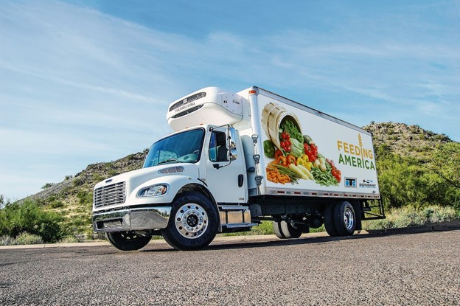
BREAD OF THE MIGHTY
ROUTING PROJECT
Cole Crawford, Ewa Wiercioch,
Venkata Praveen Naradasu
In collaboration with Dr. Kazachkov
Notes:
Cole

Slide 2
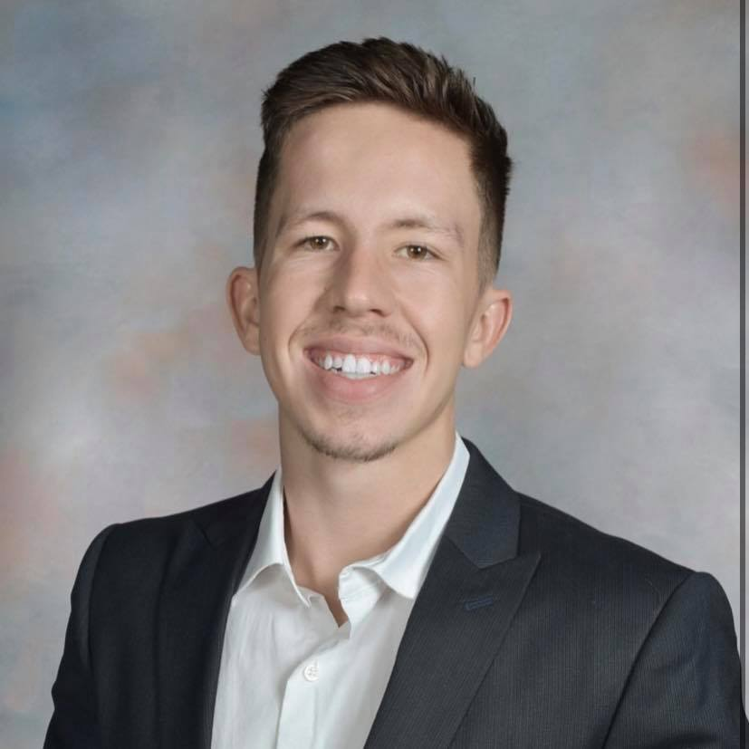
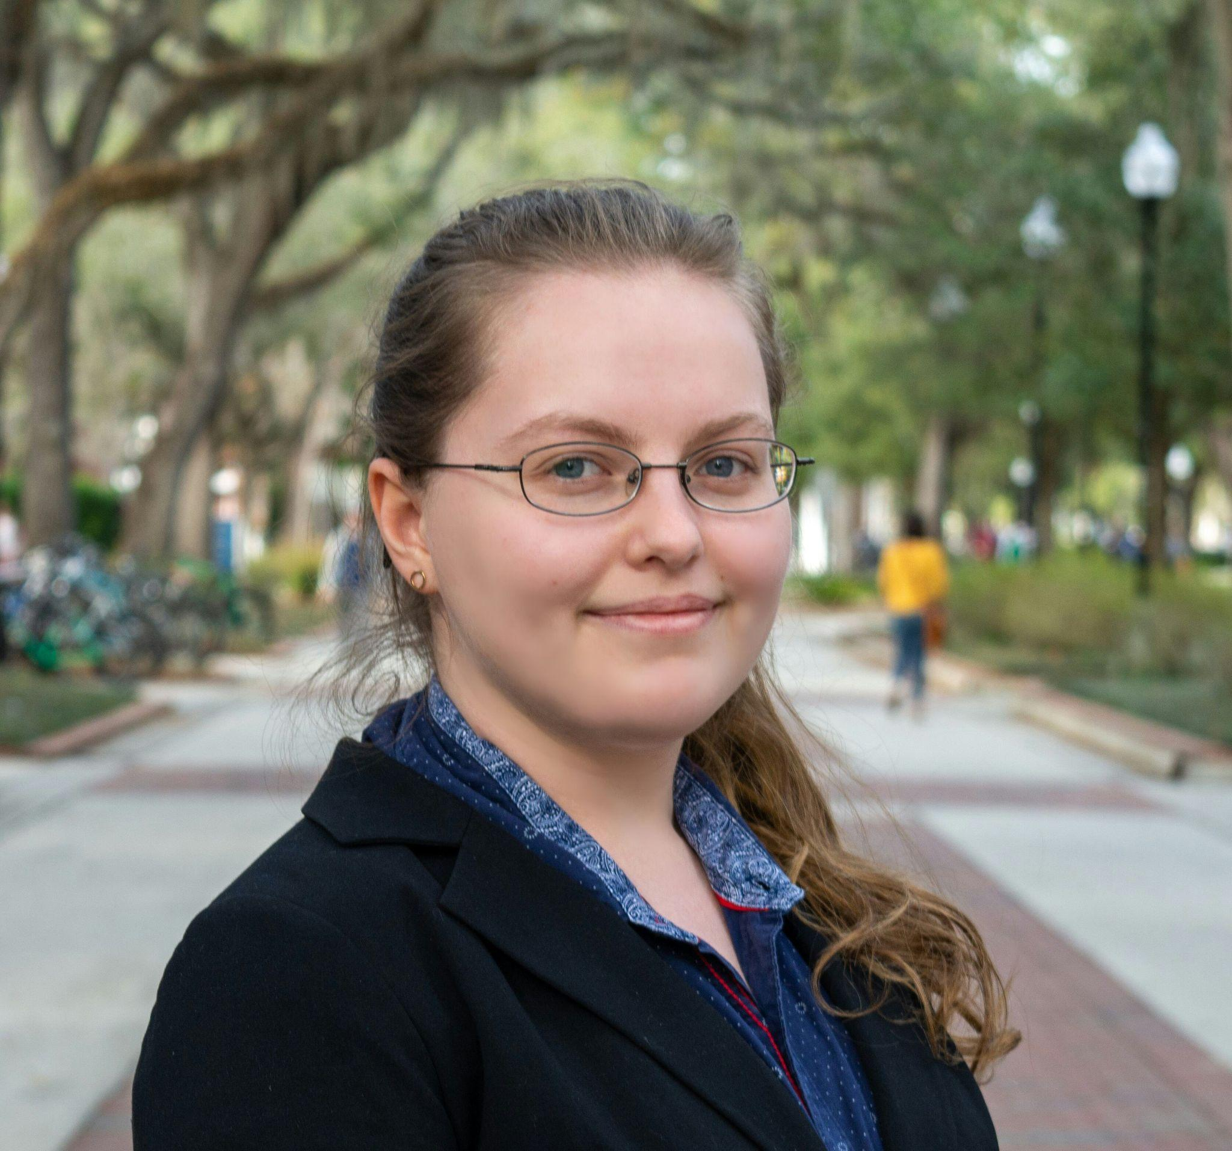
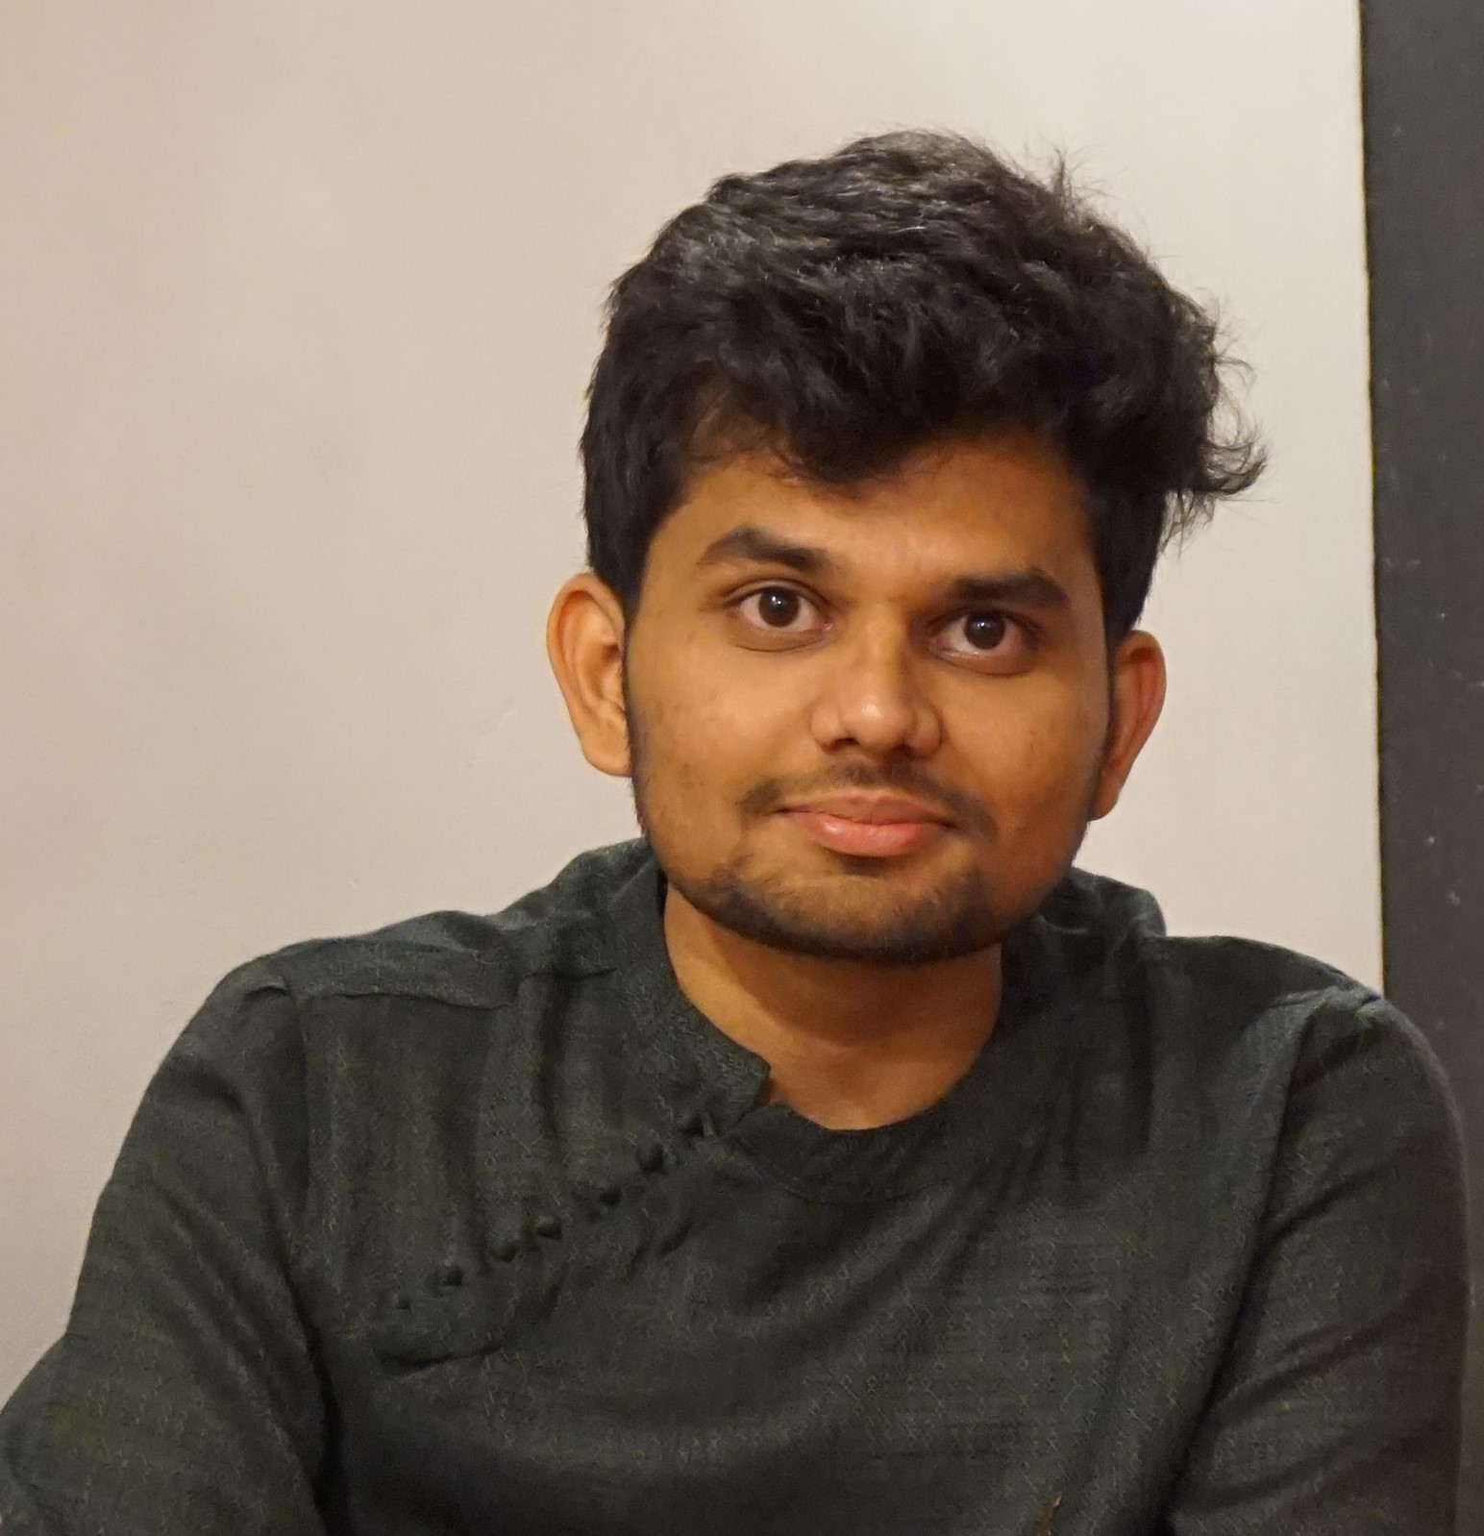
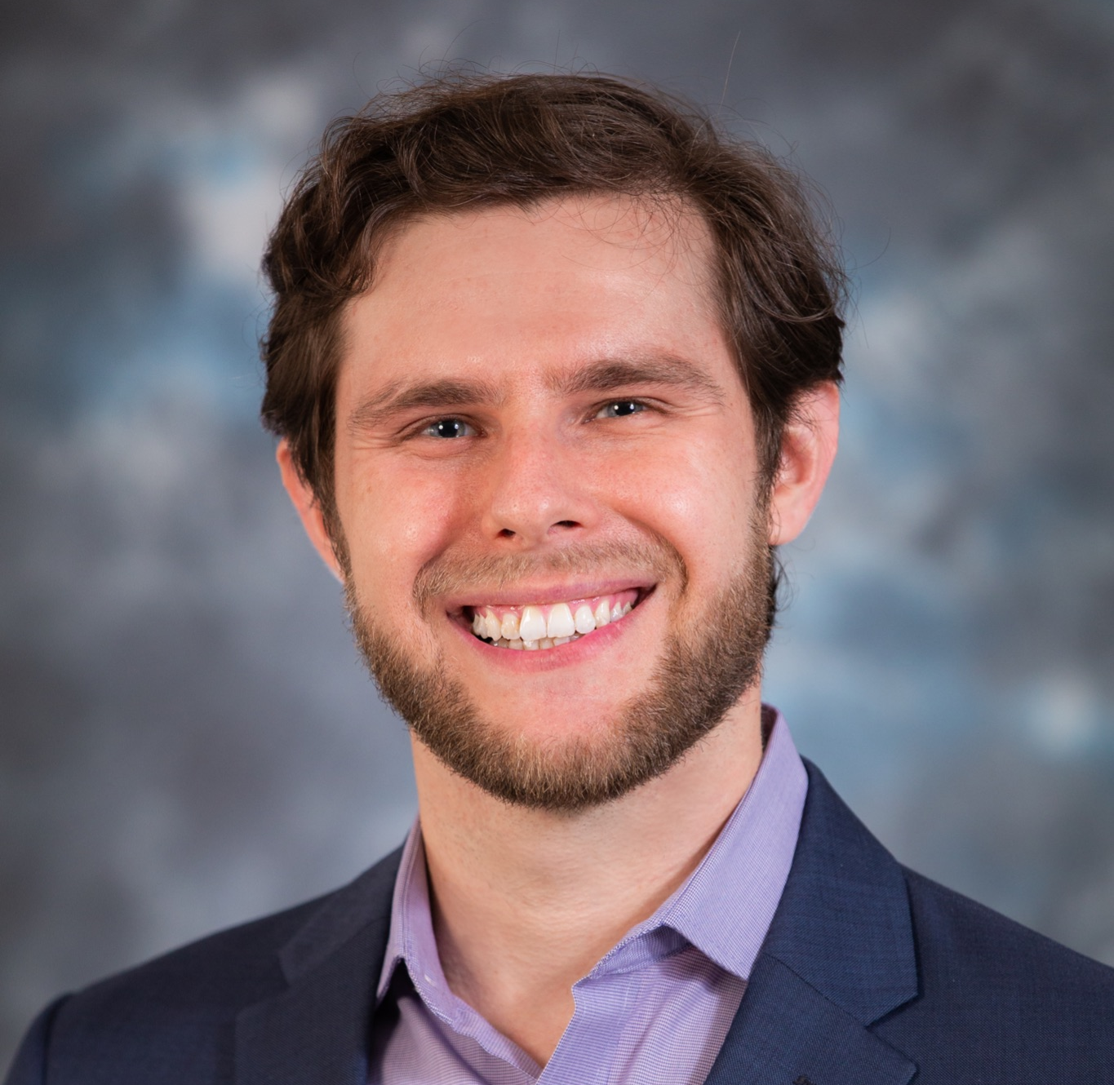
WHO WE ARE
COLE CRAWFORD
EWA WIERCIOCH
VENKATA PRAVEEN
ALEKS KAZACHKOV
UF ISE Senior
UF ISE Senior
UF ISE Grad Student
UF ISE Assistant Professor
Notes:
Cole

Slide 3
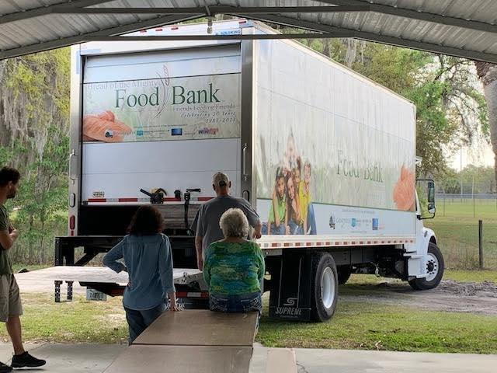
BREAD OF THE MIGHTY
Distributes 65,000+ lbs of food and necessities per month
170+ non-profit agency partners (food pantries, churches, homeless shelters)
~50 retail pickup locations
4 truck drivers
Over 70 pickups per week

Slide 4

PROJECT OBJECTIVE
To extend the impact of current BOTM resources, such as time and money, to even better serve the community.
Suggest pickup route improvements based on quantifiable data

Slide 5
01
02
03
04
CURRENT SYSTEM
Manual Routing
PROPOSAL
Visual Aid + Optimized Routing
FUTURE PLANS
Real-Time Routing
FEEDBACK

Slide 6
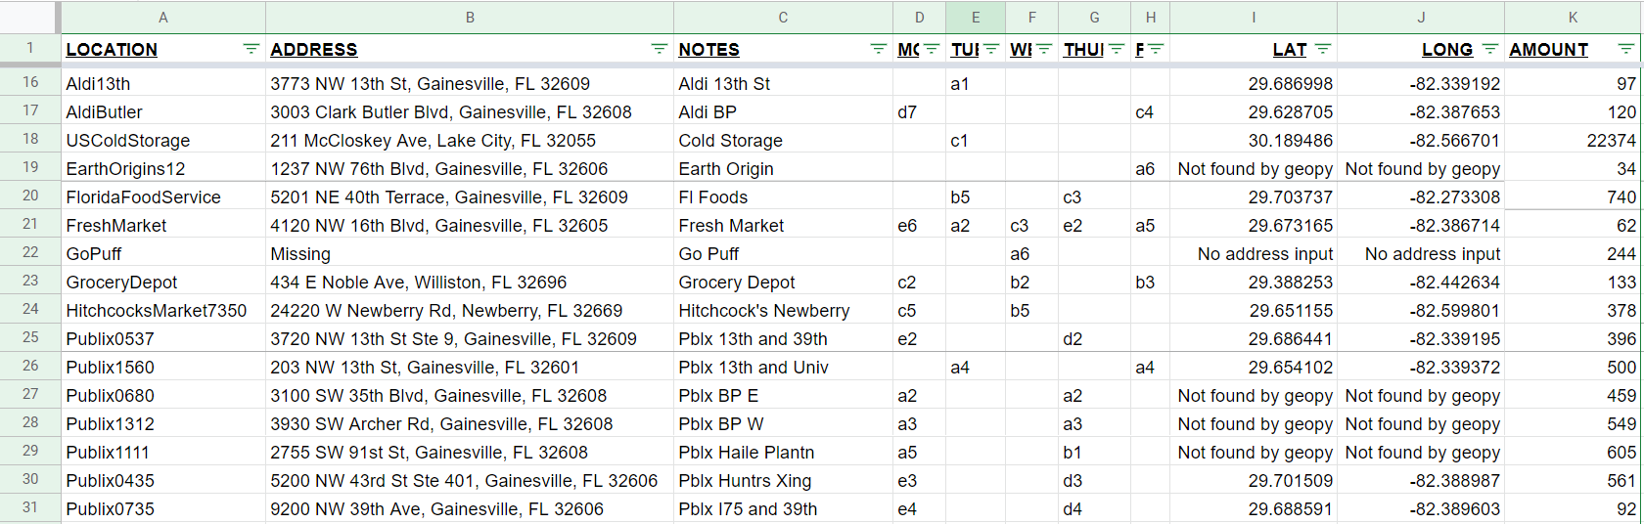
OUR PROGRESS
DATABASE
Database containing retail pickup information

Slide 7
OUR PROGRESS
DATABASE
Names kept internally by Bread of the Mighty

Slide 8
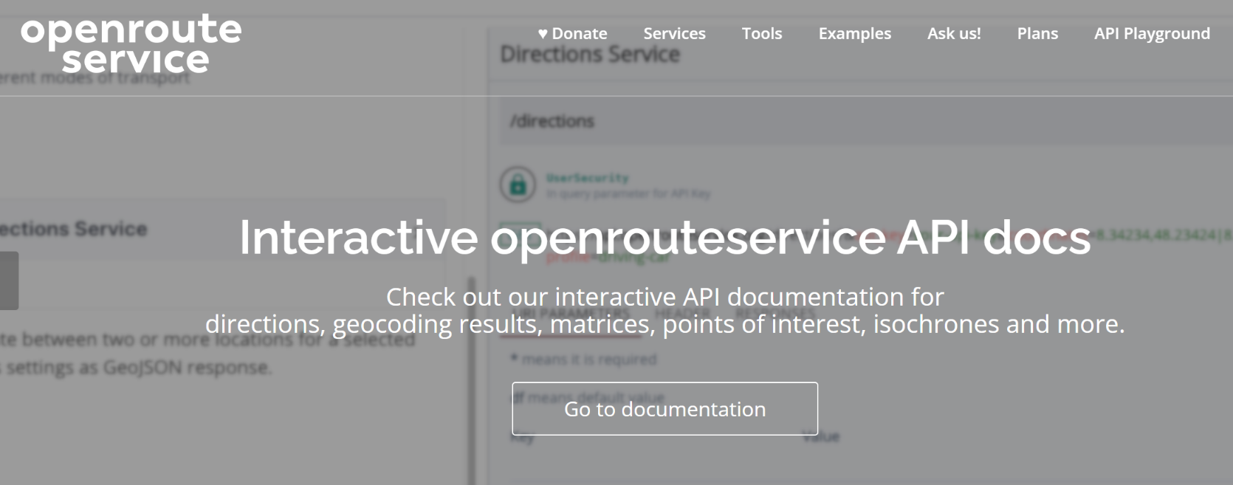
ROUTE OPTIMIZATION

Slide 9
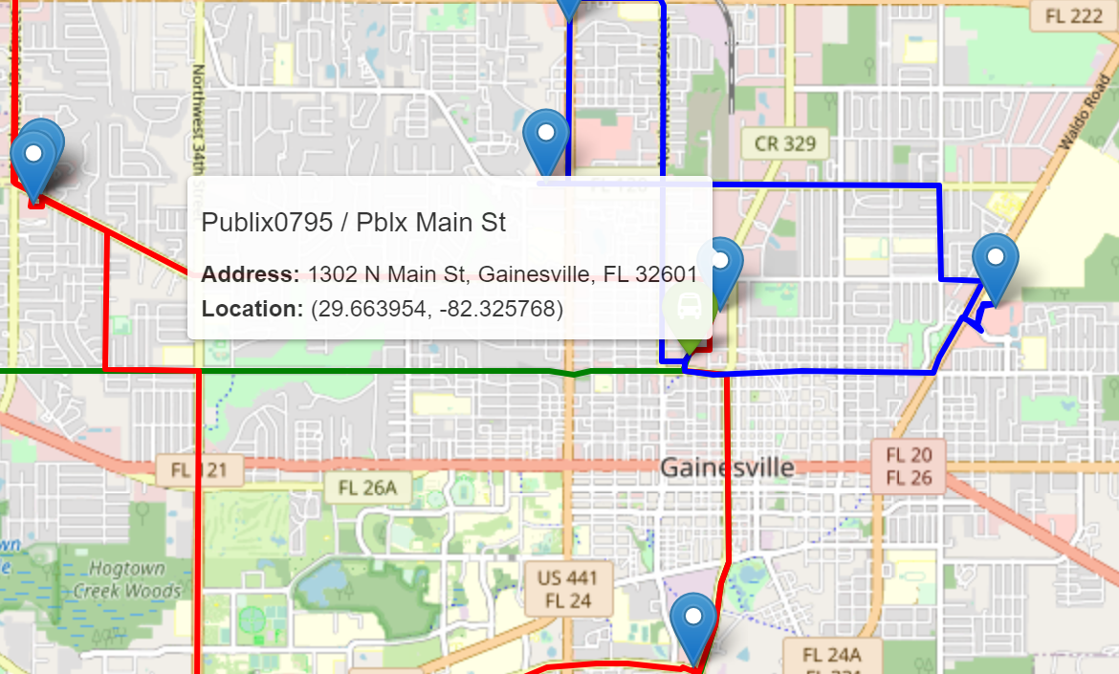
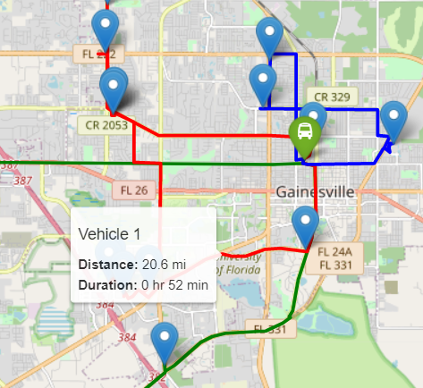
OUR PROGRESS
ROUTE VISUALIZATION
Color-coded routes
Tooltips for each location and vehicle
Notes:
Ewa

Slide 10
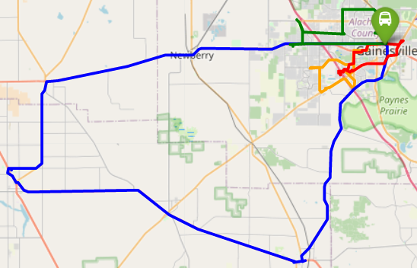
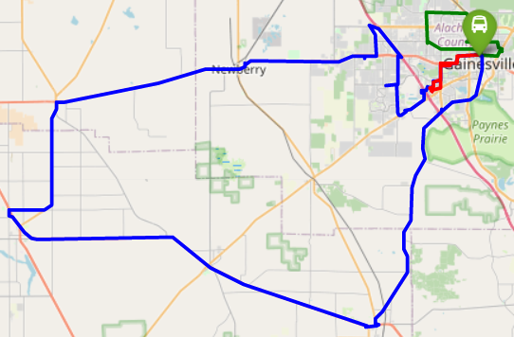
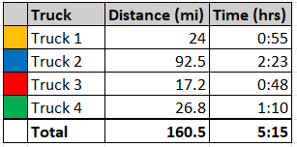
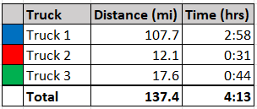
MONDAY - Before and After
Notes:
Ewa OpenRouteService

Slide 11
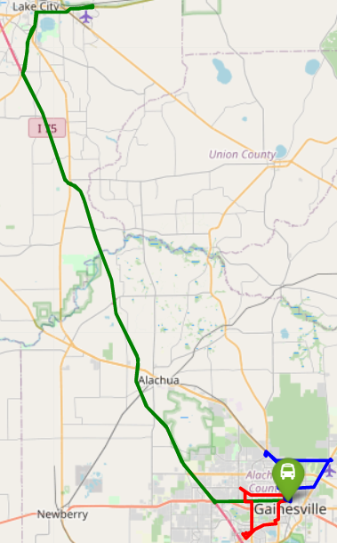
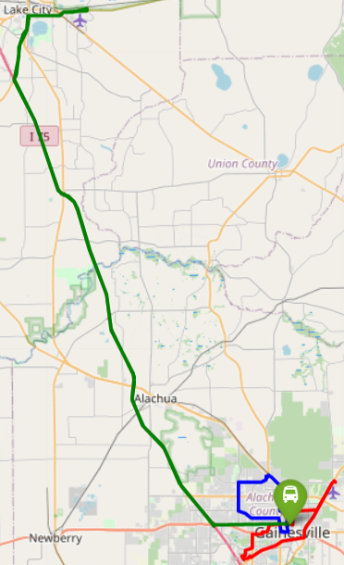
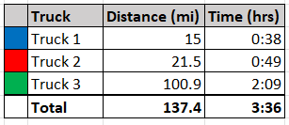
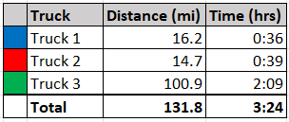
TUESDAY - Before and After
Notes:
Ewa

Slide 12

CURRENT PLAN
Set up code to run locally on our devices so that routes can be optimized for >3 trucks
Incorporate truck capacities and time windows
Create documentation for code and overall project
Notes:
Praveen

Slide 13
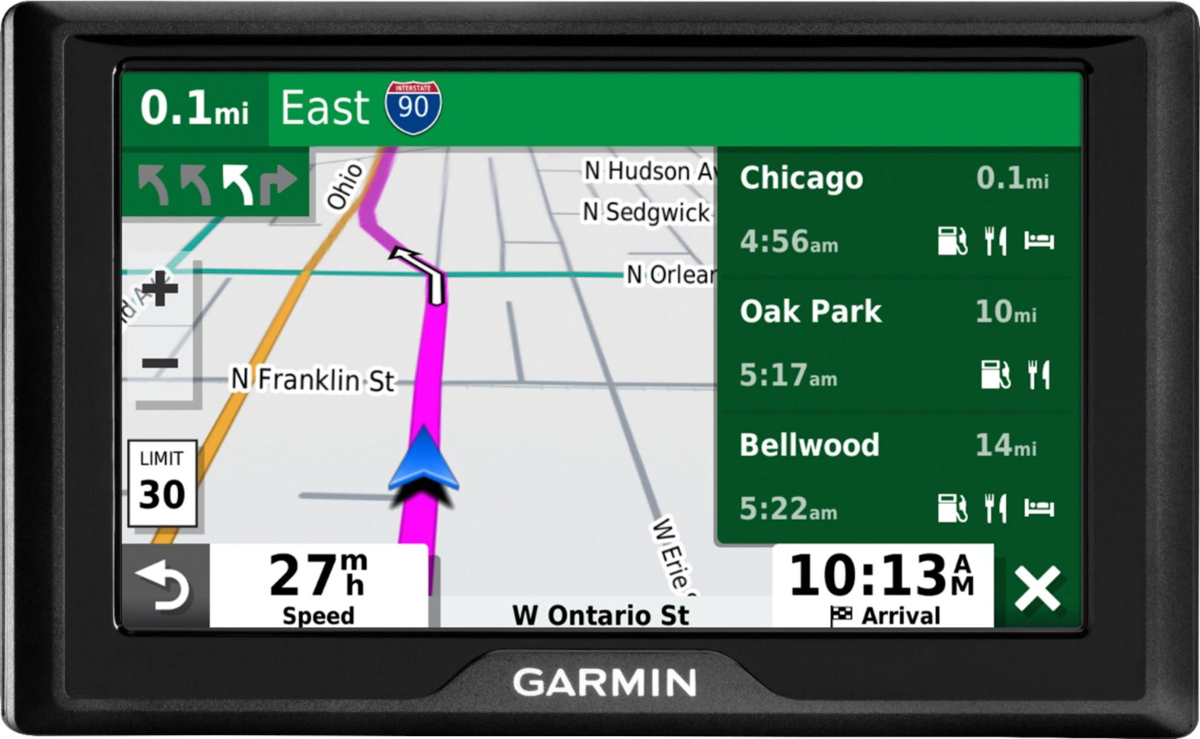
ADDITIONAL FEATURES
If time permits, based on BOTM feedback
Real-time routing in the case of last-minute pickups/cancellations
Suggest improvement opportunities to user
Notes:
Praveen

Slide 14
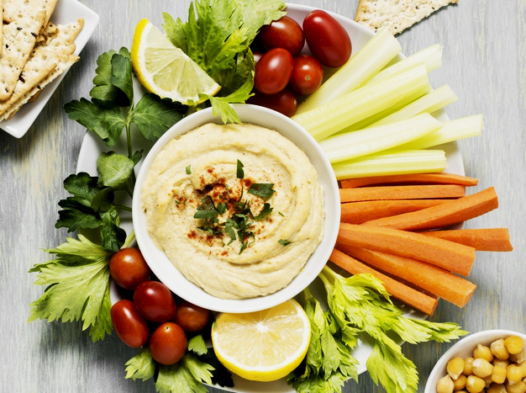
THANK YOU
We would love to hear your questions and feedback!
UF TEAM: Cole Crawford, Ewa Wiercioch, Praveen Naradasu
FACULTY: Aleksandr M. Kazachkov (akazachk.github.io)
CONTACT: akazachkov@ufl.edu
CREDITS: This presentation template was created by Slidesgo, including icons by Flaticon, infographics & images by Freepik
Please keep this slide for attribution

